Slide 1

Ph.D VIVA-VOCE EXAMINATION School of Computing Sciences
Date:12.07.2024
Time:3:00 P.M
TITLE OF THESIS
“A HYBRID FRAMEWORK FOR COVID-19 DETECTION USING
2D-HYBRID FUZZY C-MEANS AND 2D-ITERATIVE CONVOLUTIONAL NEURAL NETWORK”
Research Scholar
Ranjani.R
Reg No:UP20G9571002
Venue: STEVE JOBS BLOCK,ROOM NO:201
Research Supervisor
DR.R.PRIYA, M.C.A ,M.Phil., Ph.D,
Professor & Head of Department of M.C.A,
Department of Computer Applications,
VISTAS , Pallavaram,
Chennai-600044.
External Examiner
DR.S.BALAJI,
Associate Professor & Head ,
Department of Computer Science
D.B JAIN COLLEGE,
THORAIPAKKAM.
CHENNAI-600097

Slide 2
AGENDA
Abstract
Introduction
Structure of Covid-19 Virus
Problem Definition
Research Objectives
Literature Review
Proposed Workflow
Architecture Diagram of Proposed Work
Covid-19 Dataset
Matlab Tool
Proposed Methodologies
Conclusion
Future Enhancement
Contribution to Society
References
Conferences Attended
Papers Published

Slide 3
ABSTRACT
Covid-19 still continues to be cataclysmic danger to humankind because of new variants.
Image processing techniques and a deep learning model is implemented to bring out the detection of covid19.
A Raw Low Dose CT database Images (RLD-CTDI) along with the CAD approach to bring out a novel automatic framework is used.
To remove clamors and disturbances –Image restoration algorithm 2D IADBF is used.
To improve the image in terms of brightness and contrast 2D EPEHI is used.

Slide 4
ABSTRACT
After the pre-processing steps a clear noise-free image is obtained for further processing like clustering and thresholding.
To obtain the edges 2D Adaptive OTSU Thresholding is used.
To extract the disease clusters i.e. Region of Interest (ROI) , 2D Hybrid-Fuzzy C-Means Algorithm (2D HFCM) is implemented.
The Raw Low Dose CT Images are fed as input to the deep learning model.
For CLASSIFICATION, 2D Iterative Convolutional Neural Network is used which categorizes the CT image into covid affected / Non-covid affected image.

Slide 5
INTRODUCTION
Computed Tomography (CT) images are widely used for diagnosing multiple diseases like lung cancer, phenuomia; covid-19.
Covid-19 is a serious global health issue and spreads at a rapid rate and affects the overall functioning of the lungs.
Early identification of covid-19 using CT images is a trending topic of research in recent years.
There are two main ways of detection of Covid-19
The primary detection is a lab-based approach which involves the analysis of samples of human mucus, throat swabs, deep airway material, blood test, RT-PCR Test etc.
These samples are processed to several testing like antigen testing, antibody testing, serology test etc. The average sensitivity of these procedures is around 60-71%.
The secondary category is the usage of medical imaging techniques like CT,X-ray ,MRI,PET and Chest radiography .

Slide 6
INTRODUCTION
WHY CT SCANS?
CT images are mainly based on Computed Aided Diagnosis, which are set of automatic decision making system to overcome the problem of manual detection, work pressure and missed nodes during detection.
This decision making system makes use of iterative grounded threshold based techniques
Radiologist suggest using CT because of the below reasons like :
gives clear image of human body tumours,
monitors growing development,
good quality,
robust, error-free process ,
reliable method.
These reasons make CT images more efficient for early detection .
The obtained using Computed Tomography (CT) are subjected to various algorithms

Slide 7
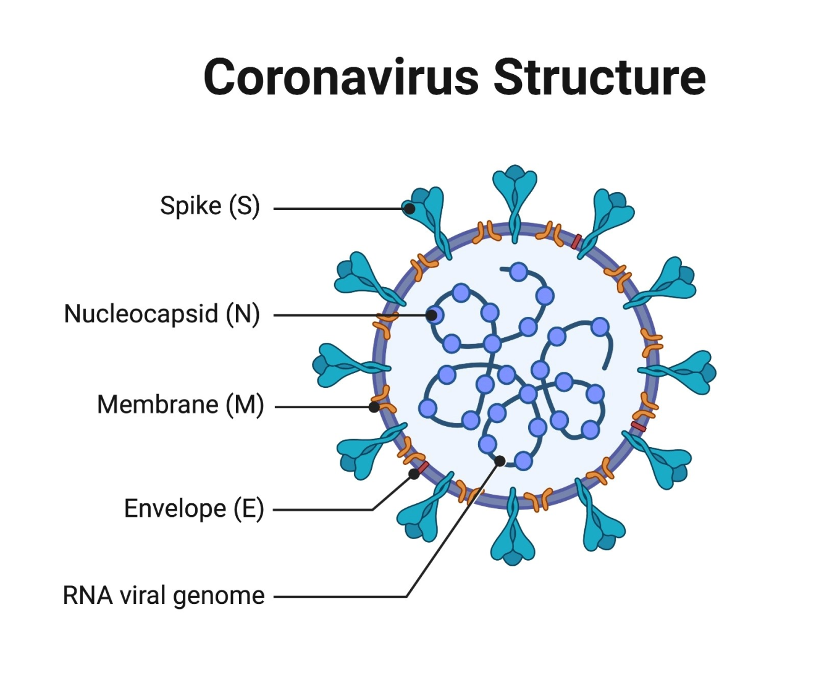
STRUCTURE OF COVID-19 VIRUS

Slide 8
STRUCTURE OF COVID-19 VIRUS
The corona virus particles are organized with long RNA polymer chain .
They are tightly packed in the centre and surrounded by a protective capsid, which is a lattice of repeated protein molecules referred to as coat.
The coat consists of proteins called nucleocapsid (N).
The virus’s core particle is surrounded by an outer membrane(M) and envelope ( E ) made of lipids (fats) with proteins inserted.
A key set of the proteins in the outer membrane(M) project out from the particle and are known as spike proteins (S).
These proteins are recognized by receptor proteins on the host cells which will be infected.

Slide 9
STRUCTURE OF COVID-19 VIRUS
The virus infects human lung cells through a receptor enzyme called Angiotensin Converting Enzyme 2 (ACE2).
The virus spike protein (S) recognizes and binds to the ACE2 receptor, leading to viral infection.
The virus is then incorporated into the lung cells and the viral RNA is released into the cytoplasm.
The viral RNA molecules recruit the cellular apparatus to make thousands of copies of the viral RNA
The RNA Polymers instruct the cells to synthesize thousands of nucleocapsid, membrane, envelope, and spike proteins.
These assemble into new virus particles which bud out of the cell surface membrane.
The cells release the newly formed viral particles propagating the infection and eventually die.

Slide 10
PROBLEM DEFINITION
Covid-19 detection is critical because it has a higher risk of spread and raise of new mutants which keeps prevailing till now.
An automated system is required to diagnose Covid-19 .
The key disadvantages of clustering model are the extreme susceptibility to activation and the failures to catch normal in-homogeneity in the lung areas.
As a consequence, it is challenging to provide the clustering model with sufficient instructions to obtain the same cluster.
Manual segmentation of CT images is time consuming and has several challenges like texture,size,location of infection.
The disadvantages to this kind of methodologies are the complexity in distinguishing the lung partition nodules.
Major differences in validation accuracies.
Reduce the Computation time and complexity in terms of huge dataset
Poor illumination and high noise levels.
PSNR value is low
MSE value is high

Slide 11
RESEARCH OBJECTIVES
To detect covid-19 in an early stage.
To Design proper performance based image Pre-processing algorithms for CT images.
To Design a gradient based infected pixels region clustering module
To increase the ability of the model without information loss.
To show the efficiency of the proposed algorithms by comparing with traditional algorithms through standard parameters.
To show that the model is independent and novel from existing works.
To develop an automated approach based on deep models for faster examination
To design a fully automated and efficient method, to classify COVID-19 infections using lung CT images.
To compare the Image Segmentation accuracy with Deep Learning (Classification) accuracy

Slide 12
LITERATURE REVIEW
Reference paper & year | Authors | Problem Identification | Author’s Proposed System | Methodology used | Results | Limitations
Automatic Lung Segmentation in low-dose chest CT scans using convolutional deep and wide network (CDWN), Springer,2018 | Akila and Anitha | In need of earlier lung segmentation and performance accuracy | To Segment lung region from chest CT for further medical diagnosis | Convolutional Deep and Wide Network (CDWN) | Dice-coefficient 0.95 Accuracy-97.6% | 1)Segmentation accuracy could be improved even with deep network and GPU 2)Higher dimension in segmentation could be done with 3D lung reconstruction
Inf-Net Automatic Lung Infection Segmentation from CT Images IEEE , Dec 31, 2020 | Deng-Ping Fan and Tao Zhou | Segmenting infected regions from CT Slices faces several challenges | To automatically identify infected regions from chest CT | A novel-Lung Infection Segmentation Deep Network | Dice-0.597 Sensitivity-0.86 Specificity-0.977 Precision-0.515 MAE-0.033 | 1)A bit drop in accuracy when compared to slice-wise classifier 2)High intensity contrast images could be used
Vestibulum congue
Vestbulum congue

Slide 13
LITERATURE REVIEW
Reference paper & year | Authors | Problem Identification | Author’s Proposed System | Methodology used | Results | Limitations
Classification of pulmonary CT Images by using Hybrid 3D Deep CNN Architecture, MDPI , Applied Sciences,2019 | Huseyin Polat And Humay Danaei | Conventional ML Techniques using Feature Extraction on CT Images are complicated | Deep Learning under ML by using Automatic Feature Extraction minimizes the process | 3D-GoogleNet | 3D-GoogleNet Accuracy-87.95% Sensitivity-82.74% Specificity-91.61% Precision-88.36% | Deep learning based RBF classifier could improve the performance of CNN Architecture in classification of 3D lung CT scanning
Automatic Detection and Staging of Lung Tumors using Locational Features and double staged Classification , Applied Sci,June2019 | May Phu Paing And Kazuhiko Hamamoto | Manual staging of cancer remains a challenge due to intensive effort required | CAD for detecting and staging cancer | Back Propagation Neural Network | Avg.Accuracy-92.8% for detection 90.6% for staging | 1)Need background knowledge for anatomical lung structure 2)Open issues can be upgraded for N&M staging of lung cancer
Vestibulum congue
Vestbulum congue

Slide 14
LITERATURE REVIEW
Reference paper & year | Author | Problem Identification | Author’s Proposed System | Methodology used | Results | Limitations
Ultrasound Image De-noising wavelet threshold methods Bilateral Filter , IEEE Latin and America, Nov 2019 | C. Rodrigues and Z.Peixoto | Previous methods are not estimating the structural features and contour preservation | New association based on Smedian Thresholding and Fast BF to remove Speckle Noise | Thresholding Methods | PSNR-14.13% increase in structural features contour preservation increase in 4.96% MSSIM-0.70% in β | Principle contribution for better thresholding
An Appraisal of Lung Nodule’s Automatic Classification Algorithm for CT Images, MDPI, Applied science,2019 | Xinqi Wang And Keming Mao | Early Detection and Reliability of Manual CT Images | Modern Computer Vision and ML on CT Images | 3D Feature based Method | Difference in accuracies using different Databases | 1)To deal with noises and uncertain annotations 2)To deal with anatomical locations of regions

Slide 15
PROPOSED WORKFLOW
IMAGE PRE-PROCESSING
IMAGE RESTORATION
IMAGE ENHANCEMENT
IMAGE SEGMENTATION
IMAGE THRESHOLDING
IMAGE CLUSTERING
DEEP LEARNING
CLASSIFICATION
CLASSIFICATION

Slide 16
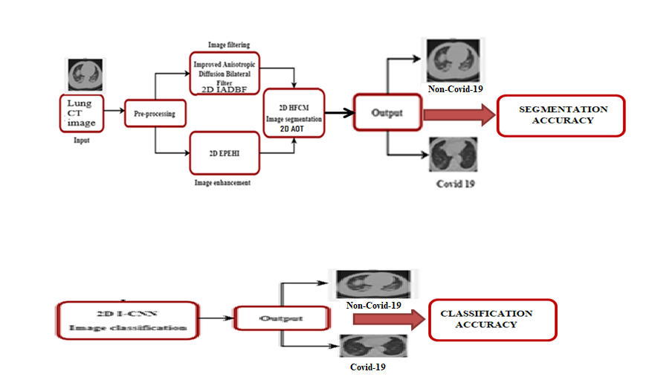
ARCHITECTURE DIAGRAM OF PROPOSED WORK
PHASE -I
PHASE -II

Slide 17
COVID-19 DATASET
The Covid lung CT images were obtained from the publicly available Real-Time Imaging Archive dataset
https://onlinelibrary.wiley.com/doi/10.1002/emp2.12073. (Journal of the American Col1ege of Emergency Physicians)
Total number of COVID-19 CT images for training and testing – 700 out of which 444 are covid and 238 are non-covid images
Proper Attestation with Doctor’s sign and seal is provided for Research Authentication.
MATLAB TOOL
The research work used MATLAB software on a Windows computer with an the Intel i3 CPU and 6GB of RAM.

Slide 18
PROPOSED METHODOLOGIES
Phase 1: Image Processing
Step 1: Image Pre-processing
i) Image Restoration using 2D Improved Anisotropic Bilateral Filter
(2D IADBF)
ii) Image Enhancement using 2D Edge Preservation Efficient Histogram Processing
(2D EPEHI)
Step 2 :Extraction of Region of Interest (ROI)
i) Image Thresholding using 2D Adaptive OTSU Thresholding (2D AOT)
ii) Image Clustering using 2D Hybrid Fuzzy C-Means (2D HFCM)
Phase 2 :Deep learning For Classification
i) Classification using 2D Iterative Convolutional Neural Network (2D ICNN)

Slide 19
PHASE 1:IMAGE PROCESSING STEP1:IMAGE PRE-PROCESSING
i) Image Restoration using 2D Improved Anisotropic Diffusion Bilateral Filter
(2D IADBF)
Image Restoration is done to filter out the noise from the lung CT images.
This is done based on the combination of anisotropic diffusion model and the bilateral filter.
The Restoration algorithm is a combination of Spatial and Frequency domain making it an Spacio-Frequency Domain ( i.e. Bilateral + Anisotropic).
Anisotropic – being an spatial domain removes noise and preserves gradient information
Bilateral – performance in speckle noise detection is very high.
Therefore the improved variation form of filtering is the 2D Improved Anisotropic Diffusion Bilateral Filtering algorithm is implemented.

Slide 20


PHASE 1:IMAGE PRE-PROCESSING
Algorithm 1: 2D Improved Anisotropic Diffusion Bilateral Filter
(2D IADBF)
Input:
Input noisy CT lung image
Steps:
Step 1: For the given input image define the anisotropic diffusion model
using Equation (1)
..…… (1)
Step 2 : The diffusion coefficient is generated based on the gradient function using
.....…..(2)
Step 3 : The gradient function is modified using bilateral function as
………(3)

Slide 21


Algorithm 1: 2D Improved Anisotropic Diffusion Bilateral Filter (2D IADBF)
Step 4 : The bilateral function is defined using the gradient function to enable accurate noise filtration using Equation (4).
……….(4)
step 5 : Finally, the filtered image is obtained using
……….(5)
Output:
Filtered image

Slide 22
Table 1. Comparison of Peak-Signal Noise Ratio (PSNR) and Mean Square Error MSE
FILTER NAME | PSNR(dB) | rMSE (no units)
2D Adaptive Median Filtering(2D AMF) | 23.13 | 0.056
2D Log Gabor Filtering(2D LGF) | 28.72 | 0.021
2D Frequency Domain Wavelet Filtering (2D FDWF) | 22.24 | 0.015
2D Improved Anisotropic Diffusion Bilateral Filtering (2D IADBF) | 48.72 | 0.005

Slide 23
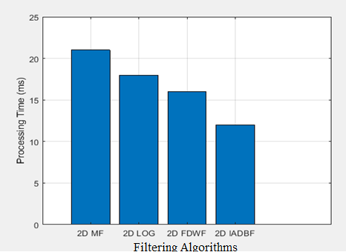
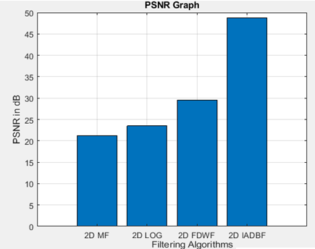
COMPARISON GRAPHS
Graph 1: PROCESSING TIME GRAPH
X-axis=Filtering Algorithms
Y-axis=Processing Time in ms
Graph 2: Peak-Signal Noise Ratio (PSNR) GRAPH
X-axis=Filtering Algorithms
Y-axis=PSNR in dB

Slide 24
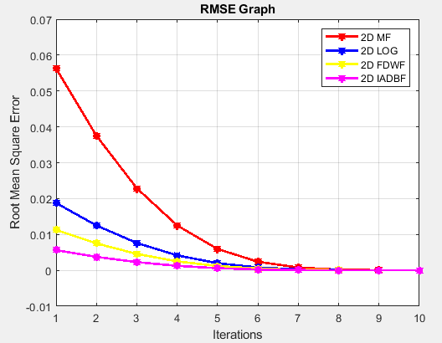
Graph 3 Comparison Of Root Mean Square Error (RMSE)
X-axis =Iterations
Y-axis=Root Mean Square Error(RMSE)

Slide 25
Phase1:Step1: ii)Image Enhancement using 2D Edge Preservation Efficient Histogram Processing (2D EPEHI)
Image Enhancement is done to improve the overall contrast of the image.
The aim of the proposed algorithm is the perform histogram improvement along with the edge preservation.
The filtered image is then divided into sub-blocks of equal size say nxn .
This sub-block is represented as a window .
For each sub-block, the Tenengrad criterion is computed.
Based on this value, the image is partitioned into 4 regions.

Slide 26
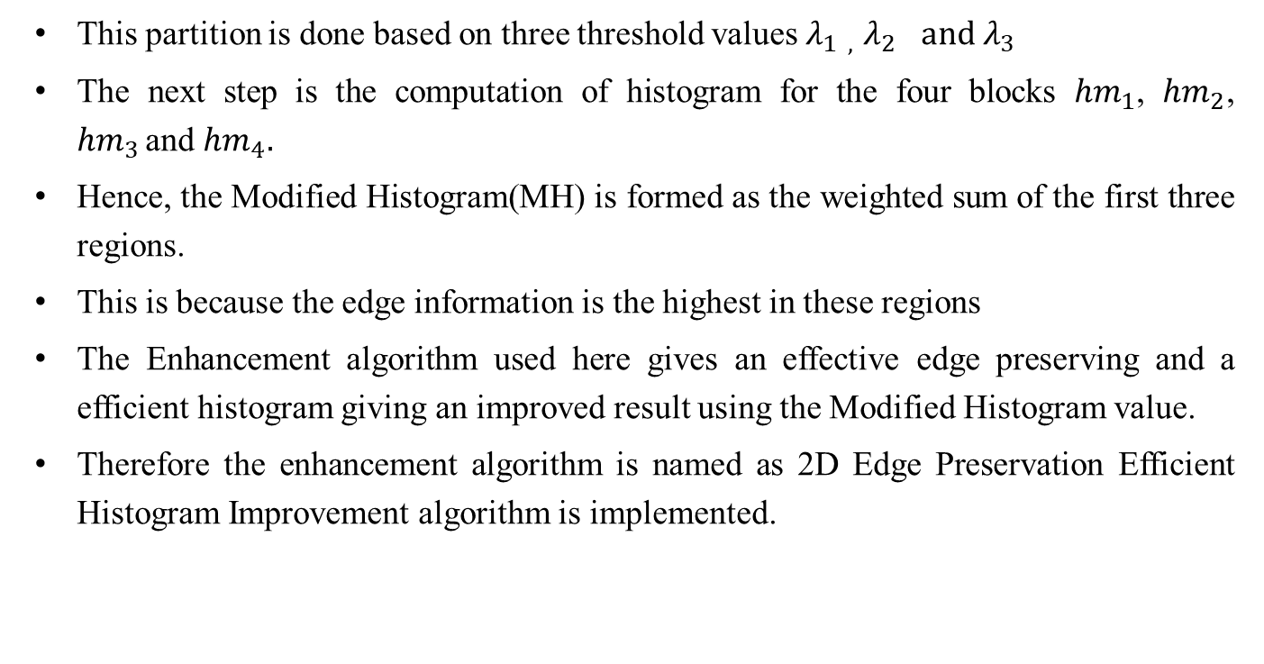
ii) Image Enhancement using 2D Edge Preservation Efficient Histogram Processing (2D EPEHI)
This partition is done based on three threshold values $λ_{1 , }$ $λ_{2 } and λ_{3}$
The next step is the computation of histogram for the four blocks ${hm}_{1}$, ${hm}_{2}$, ${hm}_{3 }$and ${hm}_{4}.$
Hence, the Modified Histogram(MH) is formed as the weighted sum of the first three regions.
This is because the edge information is the highest in these regions
The Enhancement algorithm used here gives an effective edge preserving and a efficient histogram giving an improved result using the Modified Histogram value.
Therefore the enhancement algorithm is named as 2D Edge Preservation Efficient Histogram Improvement algorithm is implemented.

Slide 27



Algorithm 2: 2D Edge Preservation Efficient Histogram Improvement (2D EPEHI)
Input:
Filtered image
Steps:
Step 1 : Divide the filtered image into sub-blocks of size n x n .
Step 2 : For each sub-block, compute the Tenengrad criterion using Equation (6).
..…..(6)
Step 3 : Calculate the overall Tenengrad criterion for a particular block using equation (7)
…….(7)
Step 4 : Divide the image into 4 regions based on the Tenengrad criterion based on 3 threshold values $λ_{1 , }$ $λ_{2 } and λ_{3}$

Slide 28

Algorithm 2: 2D Edge Preservation Efficient Histogram Improvement (2D EPEHI)
Step 5 : Compute the weight function for each histogram using equation (8)
Step 6 : Compute the modified histogram using equation (9)
……(9)
Step 7 : Find the enhanced image using the modified histogram.
Output:
Enhanced image

Slide 29
Table 2. Comparison of Structural Similarity Index Metric (SSIM) and Absolute Mean Brightness Error (AMBE)
ENHANCEMENT ALGORITHM | SSIM | AMBE
Contrast Limited Adaptive Histogram Equalization (CLAHE) | 0.25 | 10.42
2D Adaptive Mean Adjustment (2D AMA) | 0.38 | 8.53
2D Image Coherent Adjustment (2D ICA) | 0.41 | 6.96
2D Edge Preservation Efficient Histogram Improvement (2D EPEHI) | 0.44 | 4.72

Slide 30
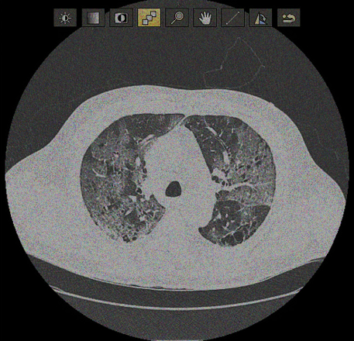
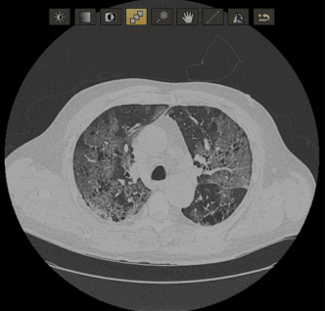
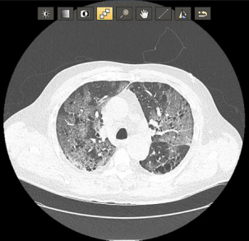
IMAGE PRE-PROCESSING OUTPUT CT IMAGES
Covid-19 CT noisy input image
(b) Proposed 2D Improved Anisotropic Diffusion Bilateral Filtering 2D IADBF
(c ) Proposed 2D Edge Preservation Efficient Histogram Improvement
2D EPEHI

Slide 31
Phase 1:Step 2: Extraction of Region of Interest (ROI)
Algorithm 3:Image Thresholding using 2D Adaptive OTSU Thresholding
In Thresholding ,the inner structures of the lungs, i.e., nodules, bronchi, and blood vessels, are separated from the parenchyma region.
The inner structures in the lungs appear as bright spots.
These spots are separated through thresholding based on the intensity levels
The intensity levels of parenchyma region and inner structures are distinguishably different.

Slide 32
Phase 1:Step 2: Extraction of Region of Interest (ROI)
Algorithm 3:Image Thresholding using 2D Adaptive OTSU Thresholding
2D AOT is used to separate the inner structure vessels, bronchi, and nodules from the rest of the region.
The key difference is their shape, and exploits this property to isolate the nodules from the non-nodules structures, i.e., vessels and bronchi.
Nodules are spherical in shape and vessels and the bronchioles are cylindrical.
Near-round shape detection algorithm proposed to identify the such shapes.
Region-growing algorithm is used for final extraction of the nodules.

Slide 33
Table 3: Comparison of Thresholding algorithms
Algorithm | True Segmented Pixels | False Segmented Pixels
Gradient Descent | 171 | 103
Binary Thresholding | 103 | 86
OTSU Thresholding | 253 | 125
2D Adaptive OTSU Thresholding 2D AOT | 256 | 128

Slide 34
Phase 1: STEP 2: Extraction of Region of Interest (ROI) ii) Image Clustering using 2D Hybrid Fuzzy C-Means (2D HFCM)
The proposed algorithm clusters CT Images into diseased and non-diseased regions.
These regions are split as non-overlapping blocks and two dictionaries are created.
1st dictionary Dr is created for the ROI region,
2nd second dictionary Dn for the non-ROI region.
These dictionaries are concatenated to a single dictionary D i.e. D= [Dr, Dn].
The enhanced image is split into a non-overlapping block bi
To block bi and dictionary D is used in the Orthogonal Matching Pursuit algorithm in which it checks if the ROI /Non-ROI portions are obtained from the input image .
Then it classifies the resultant image by using Residue condition[i.e. checks the o/p image obtained is different from the image before manipulation.

Slide 35
Phase 1: STEP 2 Extraction of Region of Interest (ROI) ii)Image Clustering using 2D Hybrid Fuzzy C-Means (2D HFCM)
Algorithm 4:2D Hybrid Fuzzy C-Means (2D HFCM)
Input: Training images, Enhanced image
Steps:
STEP 1 : Split the training images into ROI and non-ROI image blocks.
STEP 2 : Using ROI image blocks from ROI dictionary Dr blocks form non-ROI dictionary Dn using non-ROI image
STEP 3 : Form concatenated dictionary using D = [Dr Dn ].
STEP 4 : Split enhanced image as non-overlapping blocks bi .
STEP 5: Find sparse coefficient vector a using the block bi and dictionary D using Orthogonal Matching Pursuit algorithm[19]
STEP 6 : Classify each block as ROI and non-ROI using residue criterion rs (bi ) = bi- Dd_{s} (aˆ) Where s = 1, 2.
STEP 7 : The block is classified as ROI if r1 (b) > r2 (b) , else it is classified as non-ROI.

Slide 36
TABLE 3:Comparison of Segmentation parameter values
Algorithm | Segmented pixels | Gradient clusters | Intensity pixel | Min.Intensity Pixels | Max.Intensity Pixels | No of Obs | Edge Information
Fuzzy C- Means (FCM) | 438983 | 2 | 0.3378 | 0 | 236 | 7 | 476
K-Means | 637663 | 3 | 0.2187 | 0 | 250 | 7 | 763
Fast Fuzzy C- Means (FFCM) | 387365 | 5 | 0.4523 | 0 | 247 | 7 | 546
2D Hybrid Fuzzy C-Means (2D HFCM) | 26214 | 4 | 0.7169 | 0 | 255 | 7 | 512

Slide 37

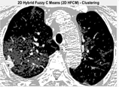
EXTRACTION OF REGION OF INTEREST (ROI)
OUTPUT IMAGES
(d) Thresholding image using 2D AOT (e) Clustered image using 2D HFCM

Slide 38
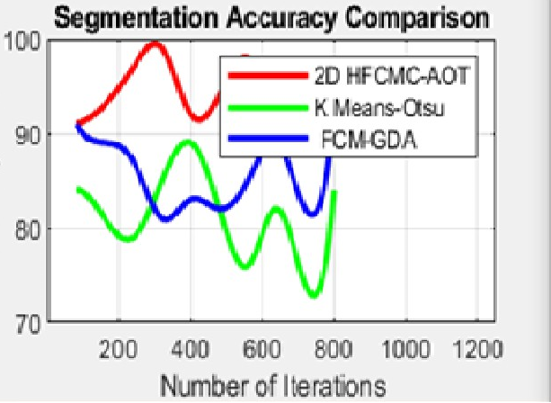
SEGMENTATION ACCURACY GRAPH

Slide 39
Phase 2: Deep learning For Classification
i)Classification using 2D Iterative Convolutional Neural Network
To identify a collection of globally distinct characteristics that capture the essence of the nodule's class-specific information using a CT scan of lung disease.
Here, 2D - Iterative Multiscale Convolutional Neural Network (2D I-CNN) is used to create CNNs to extract multi-scale properties from nodules of various sizes.
Following a set of convolutional layers is the activation function , max-pooling function and fully connected layers that provide the final output feature of Convolutional Neural Networks (CNN).
For nodule classification, it is important to reduce feature maps to eliminate duplicate information from the original nodular patch and to acquire discriminative features.

Slide 40
Phase 2: Deep learning For Classification Step 1:Classification using 2D Iterative Convolutional Neural Network
This network is trained into Epochs,Iterations and Batches
Epochs: Training a network with all training data for 1 cycle i.e. inputs are forwarded and back warded once through the network
Iterations: Number of batches needed to complete one epoch.
(Iteration =Epochs* Batches )
Batches: Number of training examples in one forward and back ward pass
( Note: Higher the batch size more the memory space is required)

Slide 41
Phase 2:Deep Learning For Classification i)Classification using 2D Iterative Convolutional neural network
How 2D ICNN is designed?
To avoid memory issues.
It Reduces the size of network by constructing iterative blocks
It Reduces computational cost and consumption time
It gives Good impact on results
ICNN process small sets of sub-sets of input and classify the accuracy based on the enhancement made
Each Iteration value is concatenated and stored in kernels k
Combines results from previous iteration and comes out with new set of results
The final Iteration value kn is used for classification (If kn>0.9-1.00-Covid affected image ; kn=0.0 –Non-covid affected image )

Slide 42
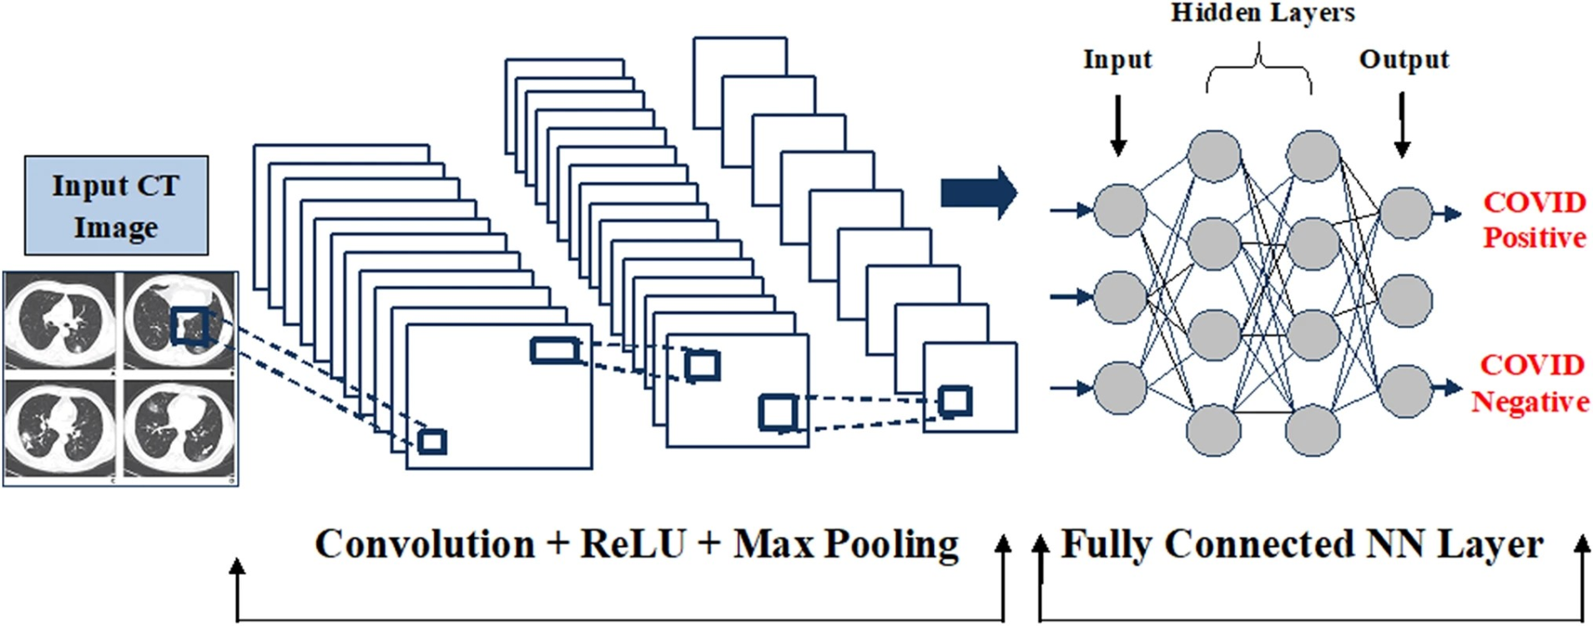
ARCHITECTURE OF PROPOSED 2D ITERATIVE CONVOLUTIONAL NEURAL NETWORK
F
L
A
T
T
E
N

Slide 43
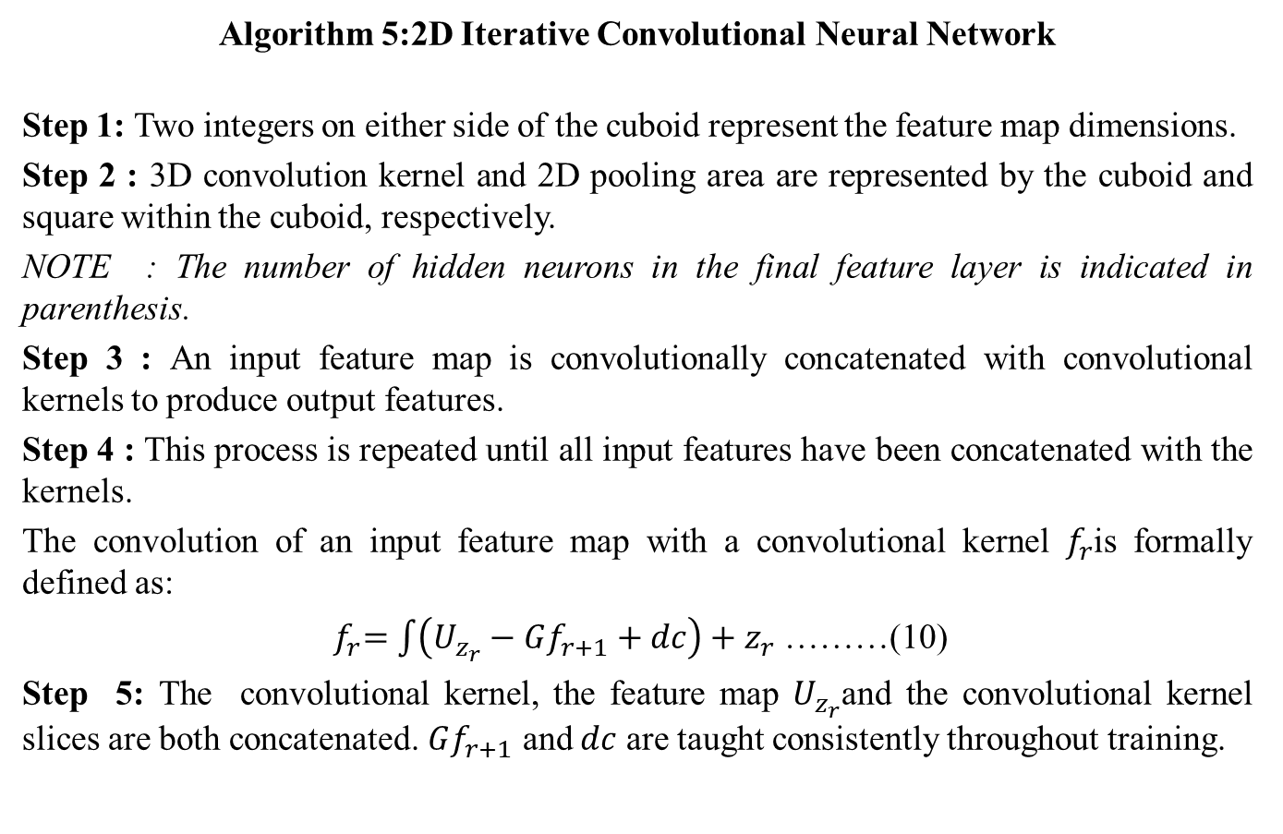
Phase 2:Deep Learning For Classification
Algorithm 5:2D Iterative Convolutional Neural Network
Step 1: Two integers on either side of the cuboid represent the feature map dimensions.
Step 2 : 3D convolution kernel and 2D pooling area are represented by the cuboid and square within the cuboid, respectively.
NOTE : The number of hidden neurons in the final feature layer is indicated in parenthesis.
Step 3 : An input feature map is convolutionally concatenated with convolutional kernels to produce output features.
Step 4 : This process is repeated until all input features have been concatenated with the kernels.
The convolution of an input feature map with a convolutional kernel $f_{r}$is formally defined as:
${ f}_{r}=\int{\left(U_{z_{r}}−Gf_{r+1}+dc\right)+z_{r}}$ ………(10)
Step 5: The convolutional kernel, the feature map $U_{z_{r}}$and the convolutional kernel slices are both concatenated. $Gf_{r+1}$ and $dc$ are taught consistently throughout training.

Slide 44
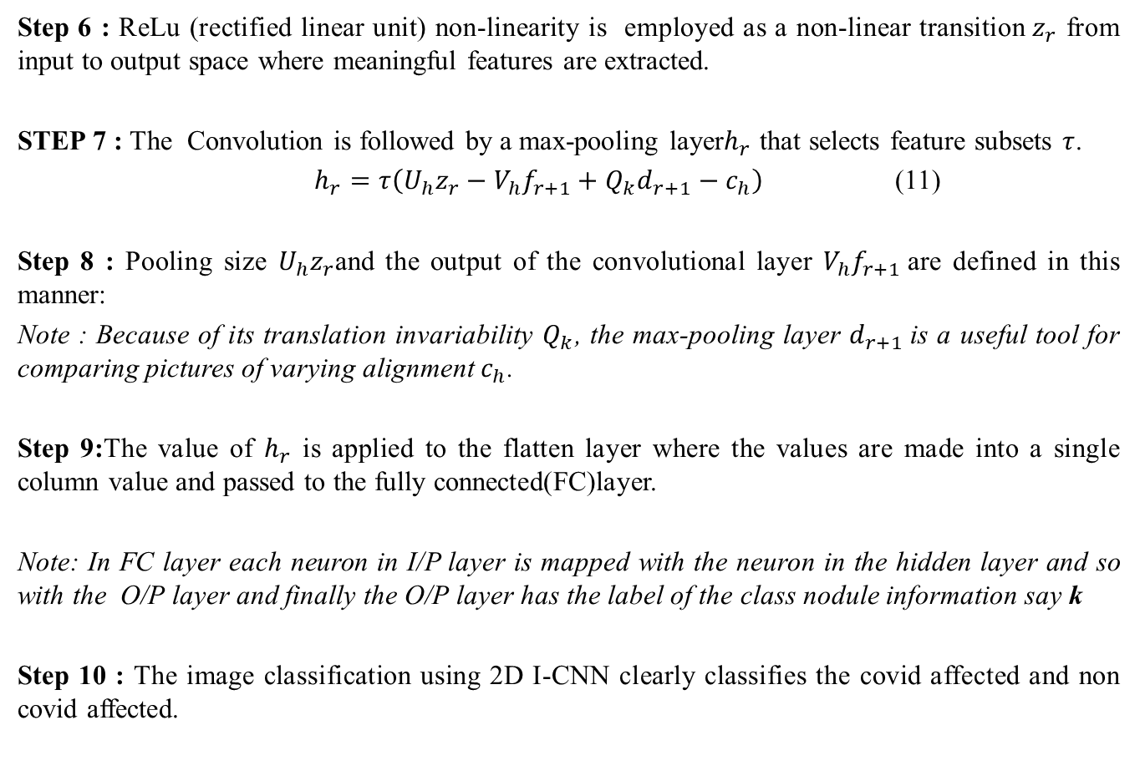
Algorithm 5:2D Iterative Convolutional Neural Network
Step 6 : ReLu (rectified linear unit) non-linearity is employed as a non-linear transition$z_{r}$ from input to output space where meaningful features are extracted.
STEP 7 : The Convolution is followed by a max-pooling layer$h_{r}$ that selects feature subsets $τ$.
$h_{r}=τ\left(U_{h}z_{r}−V_{h}f_{r+1}+Q_{k}d_{r+1}−c_{h}\right)$ (11)
Step 8 : Pooling size $U_{h}z_{r}$and the output of the convolutional layer $V_{h}f_{r+1}$are defined in this manner:
Note : Because of its translation invariability $Q_{k}$, the max-pooling layer $d_{r+1}$is a useful tool for comparing pictures of varying alignment $c_{h}$.
Step 9:The value of $h_{r}$ is applied to the flatten layer where the values are made into a single column value and passed to the fully connected(FC)layer.
Note: In FC layer each neuron in I/P layer is mapped with the neuron in the hidden layer and so with the O/P layer and finally the O/P layer has the label of the class nodule information say k
Step 10 : The image classification using 2D I-CNN clearly classifies the covid affected and non covid affected.

Slide 45
Table 5: Comparison of Classification Accuracies for CNN’S
Iterations | Recurrent Neural Network (s) | Accuracy in % | Back Propagation Neural Network (s) | Accuracy in % | K Nearest Network (s) | Accuracy in % | Iterative Convolutional Neural Network (s) | Accuracy in %
0 60 120 180 240 300 360 420 480 540 600 660 720 780 840 900 | 900.0000 880.0000 850.0000 830.0000 860.0000 850.0000 820.0000 800.0000 850.0000 900.0000 875.0000 790.0000 730.0000 875.0000 800.0000 825.0000 | 6 8 12 19 22 40 46 49.6 53.5 55.6 63.2 65.9 70 73.5 77.6 82.6 | 825 740 710 650 710 660 660 640 750 700 675 620 600 630 710 720 | 10 13 23 45 59 63 65.9 70.2 72.4 75.3 77.2 80.2 81.2 83.5 92.4 94.92 | 700.0000 690.0000 680.0000 425.0000 525.0000 630.0000 620.0000 540.0000 520.0000 610.0000 660.0000 510.0000 610.0000 500.0000 510.0000 600.0000 | 11 15 30 50 61.9 62.6 63.6 64.3 66.8 67.3 70.8 72.01 83.1 85.2 86.8 87.24 | 550.0000 475.0000 450.0000 490.0000 425.0000 530.0000 540.0000 490.0000 480.0000 525.0000 400.0000 430.0000 450.0000 500.0000 520.0000 550.0000 | 10 30 50 52 55 62 64 70 82 84 90 92 93 95 97 98.5

Slide 46
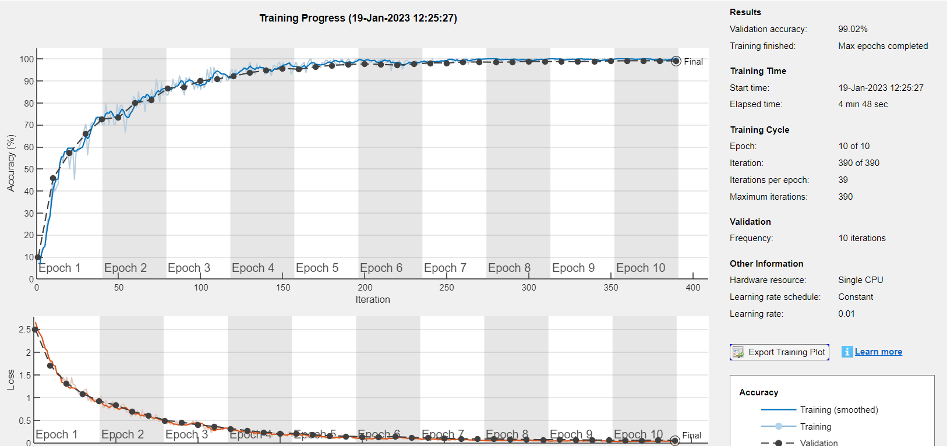
NETWORK TRAINING PROGRESS

Slide 47
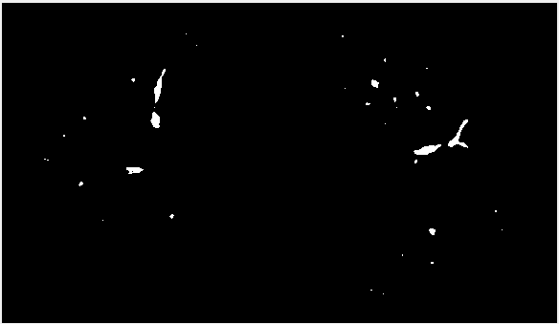

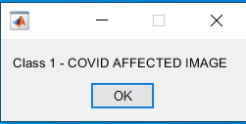
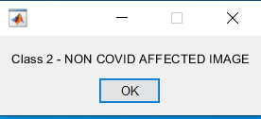
CLASSIFICATION-OUTPUT IMAGES
Class 1: Covid Affected
Class 2 : Non-Covid Affected
Ranjani.R (Full-Time)
Reg No:UP20G9571002

Slide 48
EVALUATION METRICS
Confusion matrix
False positive Reduction graph
Classification time graph
F1 Score Analysis graph
Precision Analysis graph
Correlation Fitness Factor graph
Differentiation % for correlation factor

Slide 49
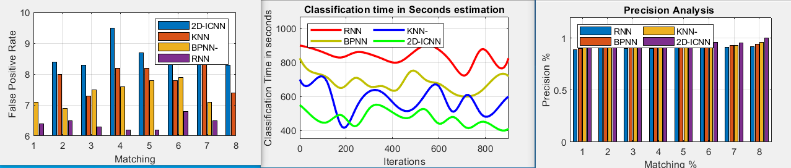
EVALUATION METRICS
(a) False-positive reduction (b) Classification time (c) Precision Analysis
X-axis =Matching
Y-axis=False-Positive Rate
X-axis=Iterations
Y-axis=Classification Time
in seconds
X-axis=Matching
Y-axis=Precision %

Slide 50
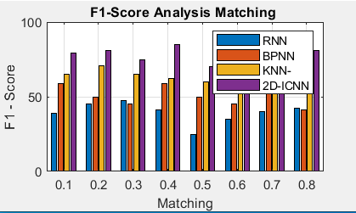
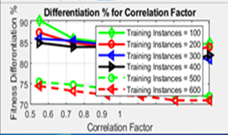
EVALUATION METRICS
(d) F1-Score Analysis (e) Differenciation % Correlation factor for proposed algorithm
X-axis=Matching
Y-axis=F1-Score
X-axis=Correlation Factor
Y-axis=Fitness Differentiation %

Slide 51
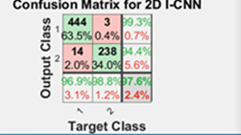
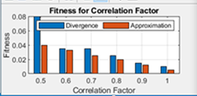
EVALUATION METRICS
(f) Confusion Matrix for
proposed algorithm
(g) Correlation Fitness for proposed Algorithm
X-axis=Correlation Factor
Y-axis=Fitness Range

Slide 52
CONCLUSION
Thus a novel, automated CAD approach is implemented in the detection of covid19 infection using CT images.
The pre-processing techniques processed the image clearly and with good efficiency making segmentation, thresholding easy.
The proposed algorithms exhibit greater efficiency when compared to the traditional algorithms
Thus both the phases image processing (98%) and Deep learning(98.5%) has given almost the same accuracy .
The proposed frameworks have improvised the work even more efficient and independent of any other existing works.
Ranjani.R (Full-Time)
Reg No:UP20G9571002

Slide 53
FUTURE ENHANCEMENT
Severity levels can be also be implemented by using CT thorax scanning where cross-sectional Images of the pulmonary system can be taken.
Double-Check analysis can be made mandatory by checking the blood sample’s microscopic Image and comparing it with the CT Images so as to avoid mislead of negative results.
The ML/DL domains can be simultaneously used for prediction of severity level
In future, DL and ML domains can be integrated with all areas of study.
Researcher can use, CT thorax scanning, ULS (Universal Lesion Segmentation) and Genetic sequencing analysis for covid-19 detection.
Artificial Intelligence based detection techniques can be used in medical Industry to bring new Imaging techniques that can detect any abnormality in patient data.
The future of Al in medical field for diagnosis is very bright which can predict and prevent future pandemics.
Ranjani.R (Full-Time)
Reg No:UP20G9571002

Slide 54
CONTRIBUTION TO THE SOCIETY
Medical field – useful for doctors, radiologists in detecting the disease in an early stage consuming less time.
The New Hybrid methods implemented can be used to detect any type of virus (via CT Scans) thereby contributing to the study of viruses
Ranjani.R (Full-Time)
Reg No:UP20G9571002

Slide 55
REFERENCES
[1] S. Akila Agnes, J. Anitha, J. Dinesh Peter, “Automatic lung segmentation in low-dose chest CT scans using convolutional deep and wide network (CDWN)”, Recent Advances in Deep Learning for Medical Image Processing.
[2] Deng-Ping Fan, Tao Zhou, Ge-Peng Ji, Yi Zhou, Geng Chen, “Inf-Net: Automatic COVID-19 Lung Infection Segmentation From CT Images”, IEEE TRANSACTIONS ON MEDICAL IMAGING, VOL. 39, NO. 8, AUGUST 2020.
[3] Yutong Xie, Yong Xia , Member, Jianpeng Zhang, Yang Song, “Knowledge-based Collaborative Deep Learning for Benign-Malignant Lung Nodule Classification on Chest CT”, IEEE TRANSACTIONS ON MEDICAL IMAGING, VOL. 38, NO. 4, APRIL 2019.
[4] Heewon Chung, Hoon Ko, Se Jeong Jeon, Kwon-Ha Yoon and Jinseok Lee, “Automatic Lung Segmentation with Juxta-Pleural Nodule Identification using Active Contour Model and Bayesian Approach”, IEEE, 2018.
[5] Pietro Nardelli, Daniel Jimenez-Carretero, David Bermejo-Pelaez, George R. Washko, Farbod N. Rahaghi, “Pulmonary Artery-Vein Classification in CT Images Using Deep Learning”, IEEE 2018.
Ranjani.R (Full-Time)
Reg No:UP20G9571002

Slide 56
REFERENCES
[6] Alwash, N. A., & Khleaf, H. K. (2022). Artificial intelligent techniques applied for detection COVID-19 based on chest medical imaging. TELKOMNIKA (Telecommunication Computing Electronics and Control), 20(2), 329-339.
[7] Zhou, L., Meng, X., Huang, Y., Kang, K., Zhou, J., Chu, Y., ... & Gao, X. (2022). An interpretable deep learning workflow for discovering subvisual abnormalities in CT scans of COVID-19 inpatients and survivors. Nature Machine Intelligence, 4(5), 494-503.
[8] Das, A. (2022). Adaptive UNet-based Lung Segmentation and Ensemble Learning with CNN-based Deep Features for Automated COVID-19 Diagnosis. Multimedia Tools and Applications, 81(4), 5407-5441.
[9] Salama, W. M., & Aly, M. H. (2022). Framework for COVID-19 segmentation and classification based on deep learning of computed tomography lung images. Journal of Electronic Science and Technology, 20(3), 100161.
[10] Rasheed, J., & Shubair, R. M. (2022, July). Screening Lung Diseases Using Cascaded Feature Generation and Selection Strategies. In Healthcare (Vol. 10, No. 7, p. 1313). Multidisciplinary Digital Publishing Institute.
Ranjani.R (Full-Time)
Reg No:UP20G9571002

Slide 57
PAPERS PUBLISHED
[1] RESTORATION AND ENHANCEMENT OF COVID-19 VARIANTS USING CT IMAGES, Frontiers of ICT in Healthcare, Lecture Notes in Networks and Systems 519,April 2023, book series ( LNNS, Volume 519), pp 485–497,Issn :Electronic ISSN2367-3389, Print ISSN2367-3370. ,SPRINGER NATURE ,Indexed in Scopus.
[2] A FUSION OF IMAGE PROCESSING AND DEEP LEARNIN FOR COVID-19 DETECTION USING 2D ITERTIVE CONVOLUTIONAL NEURAL NETWORK ,Journal of Advanced Zoology , September 2023,Volume 44,Issue 1-3,page 746-755,Issn:0253-7214. Indexed in Scopus.
[3]LUNG CANCER AND COVID-19 DIAGNOSIS TECHNIQUES USING CT IMAGES-A REVIEW, Neuroquantolog ,September 2022,Volume 20,Issue 11,page 4303-4307,Issn:1303-5150. Indexed in Scopus.
[4] A COMPARISON OF IMAGE RESTORATION TECHNIQUES OF LUNG CT COVID-19 IMAGES, International journal of Mechanical Engineering, Kalahari journals,Vol.6,3 Dec,2021,pg no, 15921593,issn:0974-5823.Indexed in Scopus.
Ranjani.R (Full-Time)
Reg No:UP20G9571002

Slide 58
CONFERENCES ATTENDED
1.)Attended the “International Conference on RECENT ADVANCES IN SCIENCE, TECHNOLOGY,ENGINEERING, MANAGEMENT AND SOCIAL SCIENCE 2023” held on 06-08,October2023 and submitted the paper “A FUSION OF IMAGE PROCESSING AND DEEP LEARNING FOR COVID19 DETECTION USING 2D ITERATIVE CONVOLUTIONAL NEURAL NETWORK“
2.) Attended the “International Conference on Recent Revolutions in Mathematics, Computer Science and Applications (ICRRMCSA’22 ) held on Sep 9th and 10th 2022 and submitted the paper “Lung Cancer and Covid-19 Diagnosis Techniques using CT Images-A Review”.
3.) Attended the “7th International Conference on Emerging Applications of Information Technology (EAIT 2022) held on March 29-31, 2022 and submitted the paper “RESTORATION AND ENHANCEMENT OF COVID-19 VARIANTS USING CT IMAGES".
4.) Attended the “VISTAS International conference on Computing and Mathematcs-2022
(VICCM-2022)” held on March 23rd & 24th 2022 and submitted the paper “SEGMENTATION & THRESHOILDING OF COVID-19 AND LUNG CANCER USING ENHANCED CT IMAGES “.
5.) Attended the “International Conference on Advances in Data Science Challenges with Big Data Analysis” held on 16 and 17-Feb-2022 and submitted the paper “EFFICIENT SEGMENTATION AND DETECTION OF COVID-19 AND LUNG CANCER”.
6.) Attended the “International Conference entitled “Multidisciplinary Research and Innovations” held on the 9th & 10th of December 2021and submitted the paper “A COMPARISON OF IMAGE RESTORATION TECHNIQUES OF LUNG CT COVID-19 IMAGES”.
Ranjani.R (Full-Time)
Reg No:UP20G9571002

Slide 59
QUERIES?
Ranjani.R (Full-Time)
Reg No:UP20G9571002

Slide 60
THANK YOU
Ranjani.R (Full-Time)
Reg No:UP20G9571002

